Slide 1
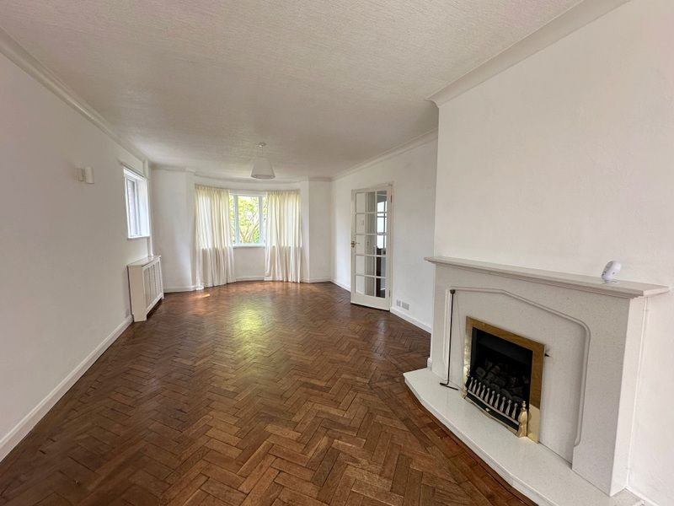
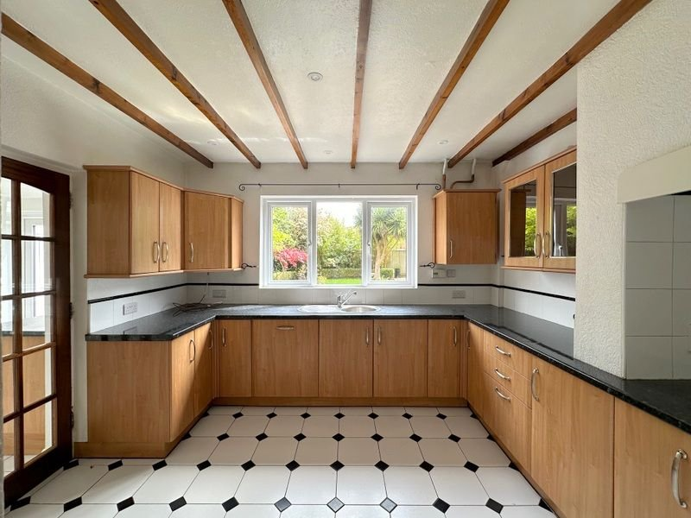
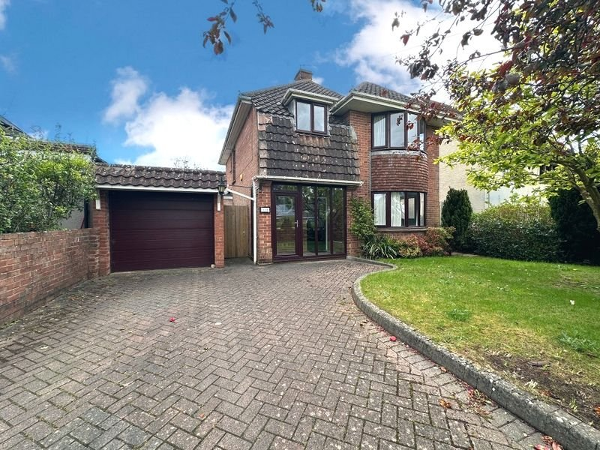
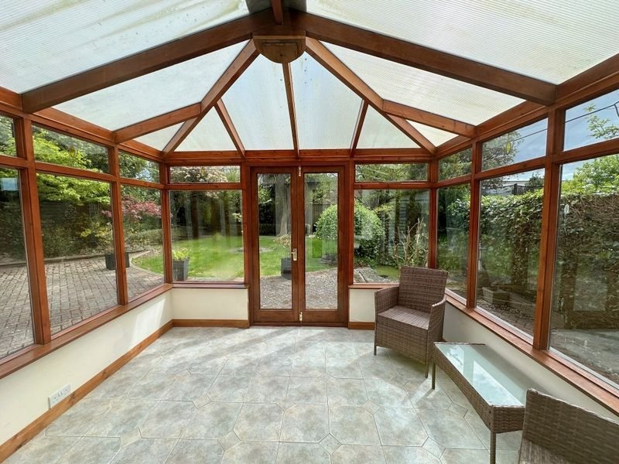
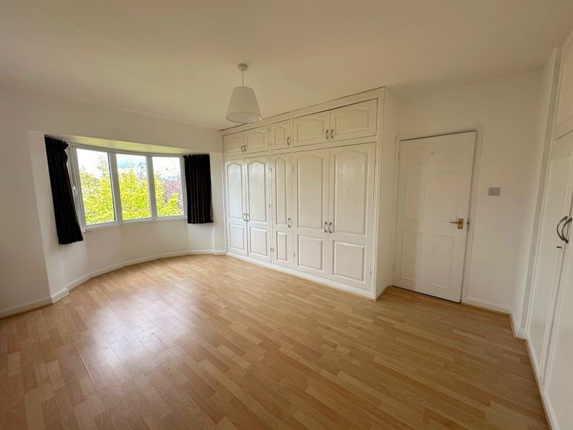
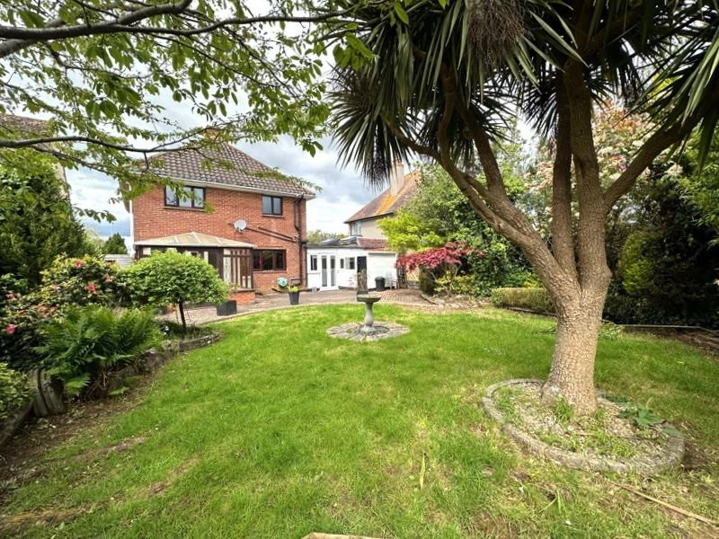
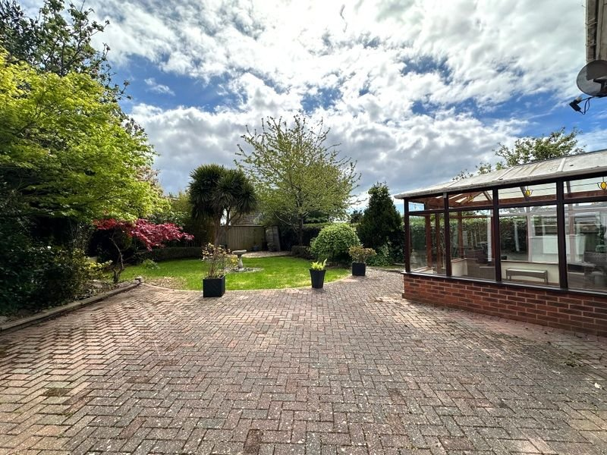
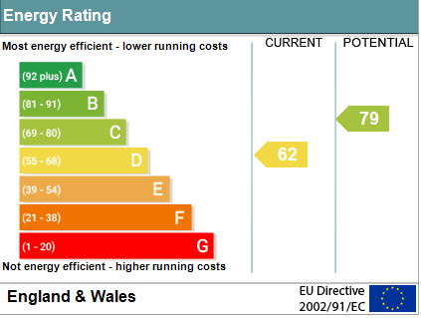
www.pennys.net
118 Hulham Road, Exmouth, EX8 3LB
PRICE £488,000
TENURE Freehold
A Spacious Older Style Detached Family House Located In A Favoured Location With Driveway, Attractive Gardens And Garage Offered For Sale With No Onward Chain
Entrance Porch • Spacious Reception Hall • 31ft Lounge/Dining Room •
Kitchen/Breakfast Room • Good Size Utility Room • Ground Floor Cloakroom/WC •
Three Double Bedrooms • Recently Redecorated Spacious Bathroom/WC •
Double Glazed Windows & Gas Central Heating • No Onward Chain •
Immense Potential To Extend If Required (Subject To Necessary Consents) •
Pennys Estate Agents Limited for themselves and for the vendor of this property whose agents they are give notice that:- (1) These particulars do not constitute any part of an offer or a contract. (2) All statements contained in these particulars are made without responsibility on the part of Pennys Estate Agents Limited. (3) None of the statements contained in these particulars are to be relied upon as a statement or representation of fact. (4) Any intending purchaser must satisfy himself/herself by inspection or otherwise as to the correctness of each of the statements contained in these particulars. (5) The vendor does not make or give and neither do Pennys Estate Agents Limited nor any person in their employment has any authority to make or give any representation or warranty whatever in relation to this property.
PENNYS ESTATE AGENTS
2 Rolle House, Rolle Street, Exmouth, Devon, EX8 2SN
Tel: 01395 264111 EMail: help@pennys.net

Slide 2
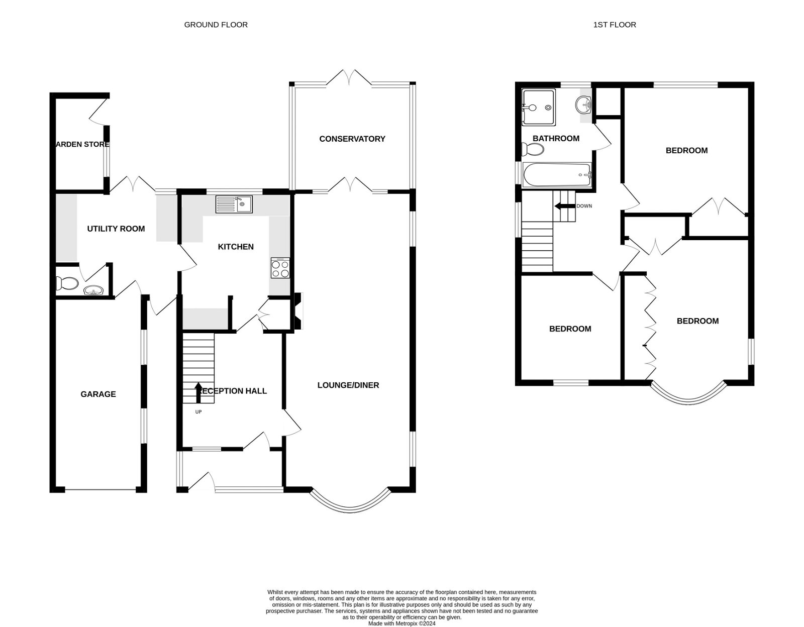
118 Hulham Road, Exmouth, EX8 3LB
THE ACCOMMODATION COMPRISES: Sliding double glazed doors to: ENTRANCE PORCH: 2.69m x 2.95m (8'10" x 9'8") Glass panelled inner door to: SPACIOUS RECEPTION HALL: Parquet flooring; radiator in feature radiator cover; cupboard with meters; stairs to FIRST FLOOR LANDING with access to understairs cupboard; porthole style window; telephone point. LOUNGE/DINING ROOM: 9.45m x 3.66m (31'0" x 12'0") narrowing 10'0 ft (3.05m). Spacious triple aspect through room with double glazed bay window to front elevation and double doors to CONSERVATORY; leaded light windows to rear elevation and two double glazed windows to side aspect; feature fireplace housing coal effect gas fire; exposed block wood flooring; two radiators in feature radiator covers; television point. CONSERVATORY: 3.15m x 3.05m (10'4" x 10'0") Tiled floor; windows and double doors to rear garden; radiator. KITCHEN/BREAKFAST ROOM: 3.96m x 3.35m (13'0" x 11'0") Fitted with a range of pattern worktop surfaces with tiled surrounds; cupboards, drawer units and integrated dishwasher beneath; wall mounted cupboards one housing gas boiler; inset single drainer sink unit with mixer tap; built-in oven oven with electric hob over; integrated fridge and freezer; radiator; double glazed window to rear aspect; tiled floor; feature ceiling beams and recess LED spotlighting; coats cupboard; glass panelled door to: UTILITY ROOM EXTENSION: 3.66m x 2.9m (12'0" x 9'6") Maximum overall measurement. A useful room; radiator; two fitted cupboards; gloss fronted wall mounted cabinet; plumbing for an automatic washing machine; uPVC double glazed doors and window to rear garden; door to GARAGE; uPVC double glazed door to front aspect. CLOAKROOM/WC: Pedestal wash hand basin; WC; tiled floor; ceiling extractor fan; LED lighting. FIRST FLOOR LANDING: With leaded light window to side aspect; access to roof space; radiator housed in feature radiator cover; airing cupboard with water tank. BEDROOM ONE: 5.08m x 3.63m (16'8" x 11'11") Into double glazed bay window to front aspect; built-in range of wardrobes; laminate floor; radiator. BEDROOM TWO: 3.66m x 3.66m (12'0" x 12'0") Double glazed windows to rear and side aspect; vanity wash hand basin; radiator; built-in wardrobe. BEDROOM THREE: 2.95m x 2.92m (9'8" x 9'7") Double glazed window to front aspect; radiator. BATHROOM/WC: 3.05m x 1.8m (10'0" x 5'11") A spacious room with bath; shower cubicle; WC in concealed cistern with push button flush; recess ceiling LED spotlighting; two double glazed windows with pattern glass; radiator.
OUTSIDE: To the front of the property there is a block paved driveway leading to GARAGE; lawn front garden edged with mature shrub beds. The rear garden is fully enclosed and enjoying a high degree of privacy with block paved patio, lawn garden with mature shrubs, palm tree and decorative stone area. Outside tap and lighting, potting shed with light and window. GARAGE: 5.18m x 2.62m (17'0" x 8'7") Electric up and over door; power and light connected; door into house.
FLOOR PLAN:

